Slide 1

AxeBot

Slide 2
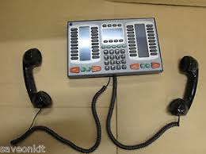


Slide 3
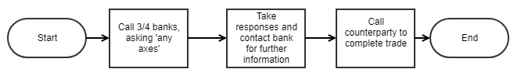
Current workflow

Slide 4
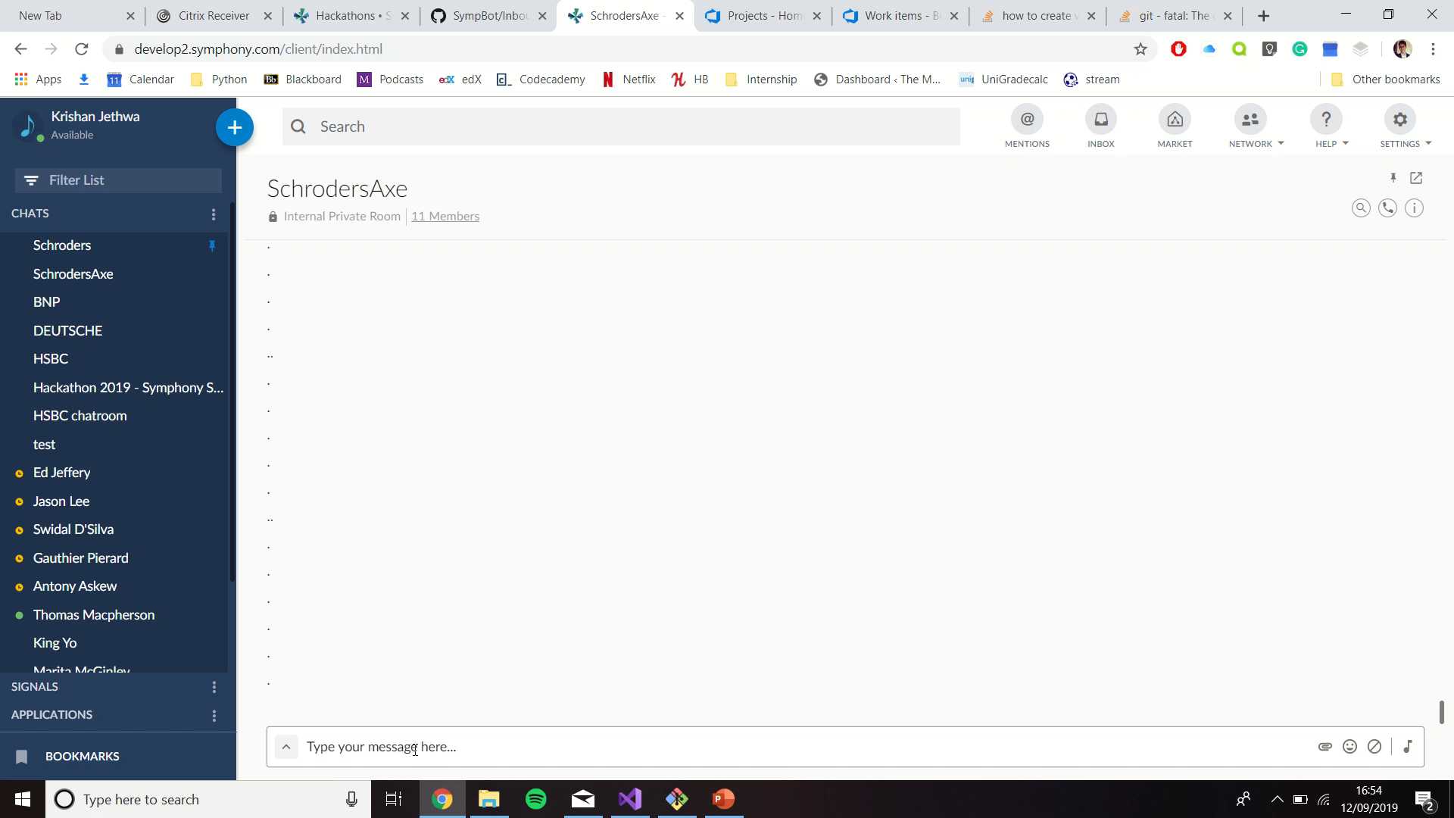

Slide 5
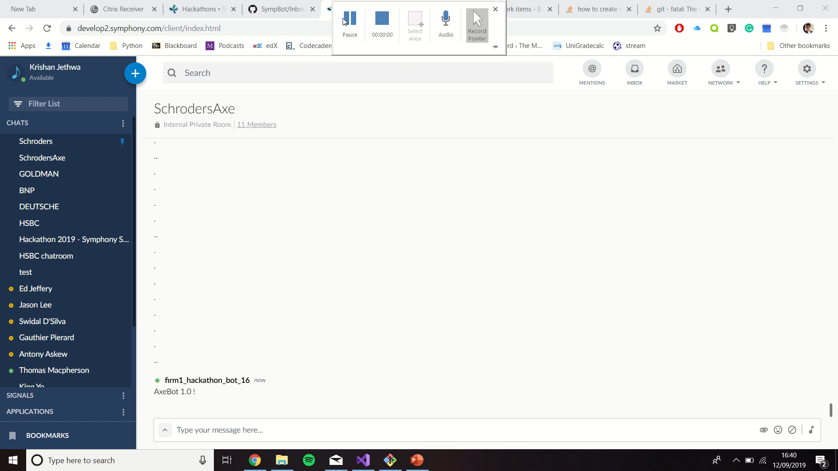
Demo

Slide 6
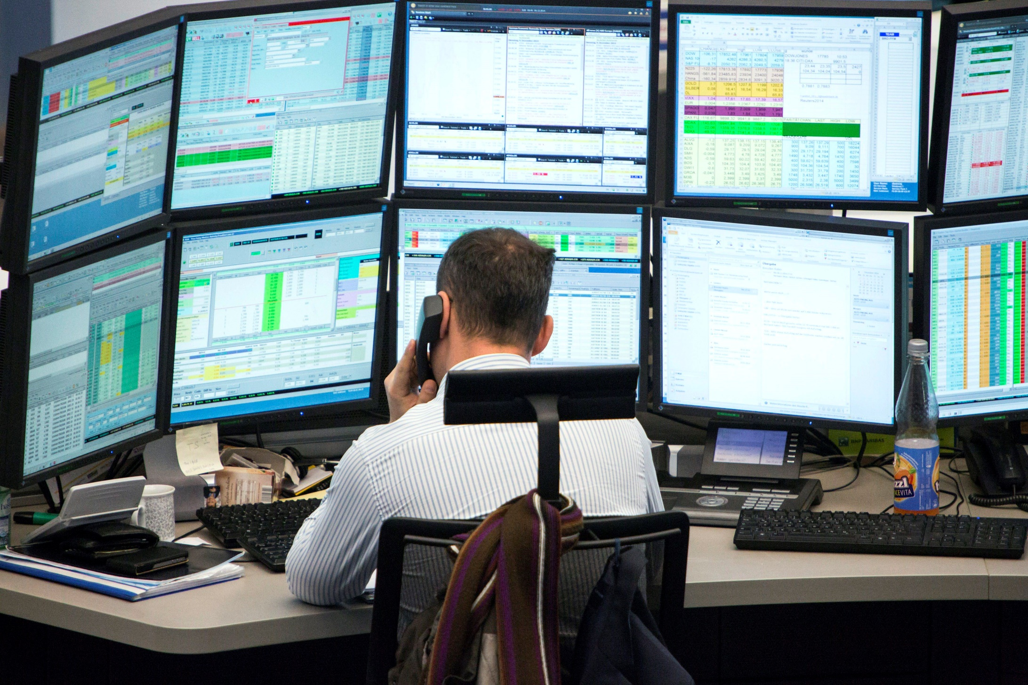

Slide 7
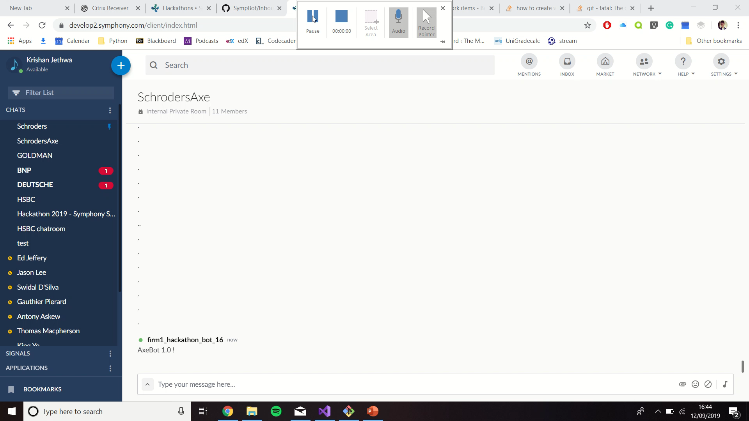
Alexa Demo

Slide 8




Conclusion
Automated a painful workflow
Better understand the market
Alexa Integration
Trader can now focus on more value add tasks, whilst at the same time they can get more information than before.
Instead of calling 2/3, you can contact all counterparties
Can activate the bot without using text.

